Slide 1
WCARC Propagation Beacons
A Primer, Status Report
and Proposal
by
Doug Leach - VE3XK
WCARC Beacon Committee

Slide 2
WCARC Propagation Beacons
Tonight’s Agenda
A primer on weak signal propagation beacons
– what they are and what they are not.
The conflicting beacon requirements and (painful) trade-offs
A proposed WCARC Propagation Beacon Program objective
Current local beacon status and what is needed
Available electronics, packaging, and suitable antennas
Location, Location, Location (and more trade-offs)
Proposed Phases 1, 2 and 3 (and timing)
Motions and votes

Slide 3
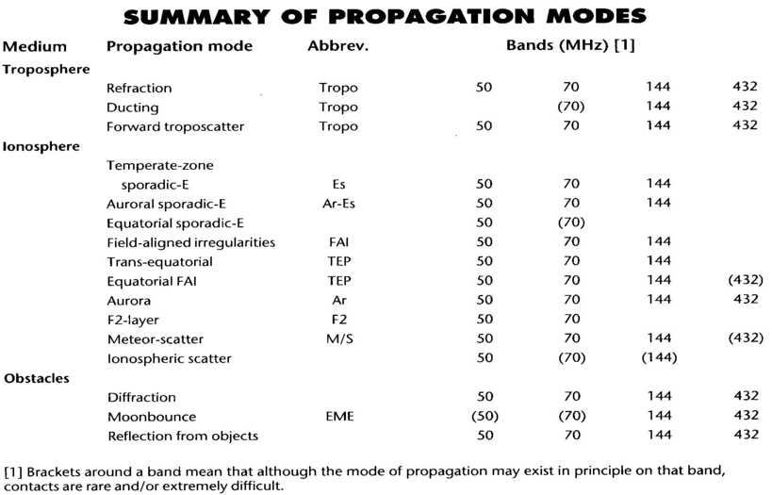
WCARC Propagation Beacons

Slide 4
WCARC Propagation Beacons
Why Beacons?
In the VHF, UHF & SHF bands, there are so many propagation modes that reliable forecasting is almost impossible.
The primary function of a beacon is to provide to distant weak signal DX operators a signal that tells them they can work into the area of the beacon’s location, regardless of the prevailing propagation or enhancement mode. Once a beacon is heard from a “needed” grid, a schedule can be arranged by phone.
Failing to hear ham beacons, most avid VHF DXers fall back on listening for distant television, FM, or repeater signals.
Co-channel interference to local TV and FM stations indicates propagation enhancement (monitor further for source)
Notes:
In the VHF, UHF & SHF bands, there are so many propagation and enhancement modes that forecasting is almost impossible.
Instead, weak signal operators depend on listening for in-band beacons which tell them propagation is occurring.
Failing hearing real DX signals, the serious DXers fall back on monitoring television, FM broadcast and repeater signals and for co-channel interference, which indicates propagation enhancement is occurring (but this is not specific to the DX location or the path).
Beacons are also invaluable to local hams as test signal sources to verify performance of their receiving equipment.
As a service to amateur radio, beacon sub-bands are reserved in each VHF, UHF, & SHF band for these important “service transmitters”.

Slide 5
WCARC Propagation Beacons
Why Beacons?
The secondary function of a beacon is to provide local hams a signal source to verify the functioning of their complete receiving systems. This secondary function is most useful when the beacon is received as a weak signal).
The major immediate beneficiary of a weak signal beacon is the distant operator. Of course the person or club who provides the beacon indirectly benefits from acquiring contacts they might not obtain otherwise. Also they may be able to take advantage of the beacon as a signal source.
As a service to the amateur radio community, a beacon sub-band is reserved in each of the VHF, UHF & SHF bands for these important broadcast transmitters.

Slide 6
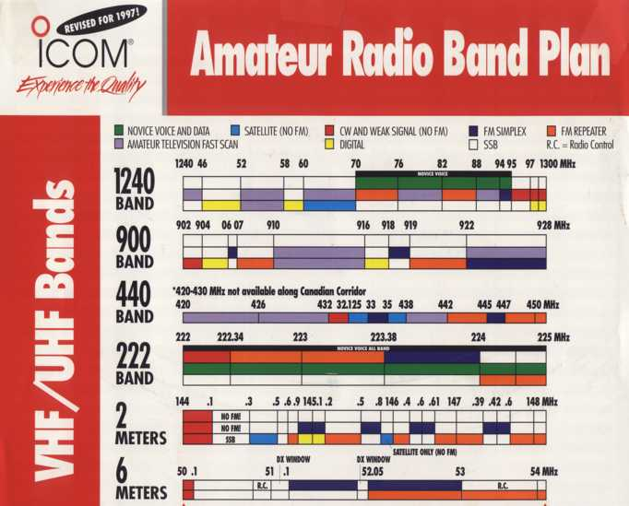
WCARC Propagation Beacons
Beacon Sub-Bands
6M:
50.000 – 50.100
2M:
144.275 – 144.300
1.25M:
222.000 – 222.080
70CM:
432.300 – 432.400
35CM:
903.300 – 903.400
23CM:
1296.00 – 1296.800

Slide 7
WCARC Propagation Beacons
Beacon Requirements
The frequency of a beacon should be carefully chosen to avoid interference with existing beacons and must be stable so it does not drift onto or near the frequency of another beacon over time and with ambient temperature changes.
The following beacon requirements reveal the inherent conflicts to be resolved between the interests of the avid VHF DXer (who uses beacons regularly) and other operators who never or seldom use beacons so may resent what they may view as simply “local interference” from a nearby beacon.

Slide 8
WCARC Propagation Beacons
Requirement Tradeoffs - 1
A beacon should have a clean stable signal with excellent reliability but be simple and inexpensive to deploy and maintain
Once it is put into service as a public service transmitter, DX users will come to depend on it for propagation assessment, but this means it should be seldom shut down for any reason.
A beacon should have enough output power to reach those DX destinations that its creators want to contact, but low enough that it doesn’t “desensitize” nearby ham receivers on that band.
Instead of lowering its power below usefulness, a beacon could be located far enough away from any (?) local station that it is received as a weak signal, but not far enough away that it is in a different propagation footprint.

Slide 9
WCARC Propagation Beacons
Requirement Tradeoffs - 2
A beacon should have an easy to copy (slow) identifier, and carry enough information that the distant user knows its call sign and location but it should identify every 15 seconds or so, so the distant user does not have to struggle for long to copy its possibly very weak signal buried in noise.
An “enhanced” beacon could transmit with stepped output power like the IARU beacons, but it and users would then have to be either synchronized to an atomic clock, or have a receiving function so it could be controlled by the user.
The above tradeoff choices are for WCARC to make over time through the choice of location, power, down-times, etc.

Slide 10
WCARC Propagation Beacons
The Store-and-Forward Repeater
The ultimate test device for local users is a facility that can receive and send back any one or all of the analog and digital modes, possibly with output power controlled in 10 dB steps.
For that, you need a computer-controlled transmitter/receiver with software for this application and desired modes.
WCARC member Kieran - VA3KS has created one of these for SSTV on 2M with excellent results. Others have done this for other modes at HF. It is feasible in any mode on any band.
Though such a facility is very useful for local users, it is not a beacon and not related to weak signal propagation.
Sometime in the future, WCARC may want to tackle a remote-controlled multi-mode club station, but that project would not be directly related to this propagation beacon program.

Slide 11
WCARC Propagation Beacons
Our WCARC Propagation Beacon Program
Since beacons are so important above 50 MHz, what should be our WCARC Propagation Beacon Program ultimate objective?
To avoid controversy, and to give us future flexibility, I propose the following wording:
“To provide a weak signal propagation beacon on each VHF, UHF and SHF band of club interest, located for maximum user benefit to both local and distant radio amateurs”
I will be asking you to vote on a motion to approve the above wording as the WCARC beacon program objective.

Slide 12
WCARC Propagation Beacons
Current Local VHF/UHF Beacon Status
WCARC operates a 35CM beacon (VE3WCC) from FN25di
Member Bill W4TAA has offered to donate a 6M beacon for use in the WCARC beacon program. This beacon is based on a professional radio, with programmable power of 1W to 100W. It could be located at the W4TAA location, at least temporarily. While there it would be shut down during contests.
I will be asking you to vote on a motion to gratefully accept Bill’s 6M beacon into our VE3WCC beacon program, to be deployed at FN15, with suitable antenna provided by WCARC, until an alternate location can be decided. At about $100 antenna cost, this will be our least expensive beacon.

Slide 13
WCARC Propagation Beacons
Current Local VHF/UHF Beacon Status (cont’d)
Under callsign VA3SJS, Member Kieran Shepherd (VA3KS) is currently running a 2M beacon at his home (FN15wg).
Last year, Tom (VA3NFA) ran a temporary 70CM VE3WCC beacon in FN25bh using a transverter. This hardware is available to WCARC but it is not compatibly packaged and does not meet the requirement for reliable unattended operation.
I will be asking you to vote on a motion to return the equipment to the donor(s), with thanks, or to sell it, at their discretion.
In summary, there are beacons currently on 35CM and 2M. Our priority should be to activate Bill’s 6M beacon and to deploy beacons on 1.25M and 70CM. Later we can add 23CM

Slide 14
WCARC Propagation Beacons
Our Other WCARC Beacon Hardware
VA3NFA acquired several old VHF Engineering, Inc modules including exciters and low power amplifiers, plus an ID-omatic Keyer. To date, over forty man hours has been spent on these.
The 2 & 6M units are almost working but not needed, as noted.
A beacon is on continuously and unattended, so stability and reliability are paramount. Freedom from harmonics & spurious output is highly desirable, when near other on-air equipment.
The VHF Engineering units are 1960’s technology. As they have no ovens, and were designed for lowest price, projected stability and signal quality are poor. Reliability is also doubtful.
I will be asking you to vote on a motion to also return these modules to Tom VA3NFA, or to sell them, at his discretion.

Slide 15
WCARC Propagation Beacons
Today’s Beacon Marketplace
With VHF Engineering long defunct, Hamtronics, Inc seems to be the only source today for beacon transmitter modules.
They are located near Rochester, NY and offer factory service
According to the Hamtronics web site, they provide the same ham radio use products, with both FAA and FCC type approvals, for commercial OEM applications. Their exciter modules have been running reliably for years in ham and professional repeater, beacon, telemetry, datacom and space applications.
Member Phil - VE3CIQ has used and approves their products.
Instruction manuals for their exciters & keyer, (with schematics and parts lists) have been downloaded, for your inspection.

Slide 16
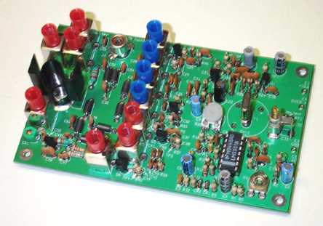
WCARC Propagation Beacons
Model TA51-50, -144 & -222 VHF Exciters (3” X 5”)
Up to 3 W output. No power amplifier is needed.
Harmonics & Spurious: –50 dB. Sideband Noise at 15 KHz (repeater spacing): –80 dB. This is acceptable performance.
With crystal oven fitted, they say no need for enclosure heating

Slide 17
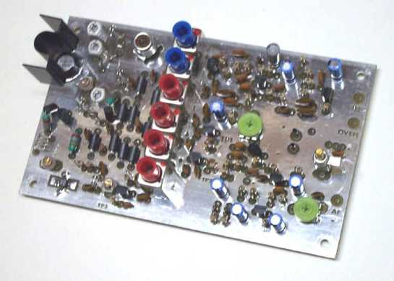
WCARC Propagation Beacons
Model TA-451 UHF Exciter – 70CM Up to 3W Out (also 3” X 5”)
Harmonics & Spurious –50 dB; Sideband Noise (15 KHz) –80 dB
With crystal oven fitted, they say no need for enclosure heating

Slide 18
WCARC Propagation Beacons
Hamtronics Exciter Pricing Details
Model TA-51 and TA-451 Kit US$ 139
Model TA-51, TA-451 Wired & Tested US$ 209
Commercial grade crystal cut to frequency
+/- 5 ppm (10C to + 60C) US$ 25
OV-1 Crystal Oven +/- 2ppm (-30C to +60C) US$ 40
A5 Special Type RCA Plug c/w cable clamp US$ 0.75
A27 6ft length miniature coaxial cable US$ 3

Slide 19
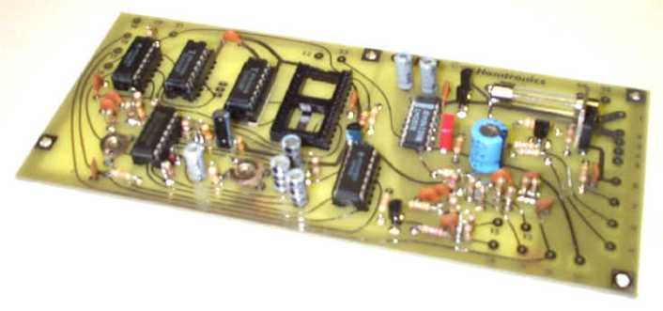
WCARC Propagation Beacons
COR-4 Controller - 3” X 7” Provides CW ID using EPROM
Specs and reliability match Hamtronics exciter modules
Low-current drain CMOS - for with battery-powered repeaters
Multiple control outputs for keying of multiple exciters

Slide 20
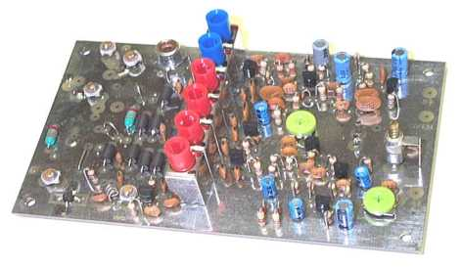
WCARC Propagation Beacons
TB-901 SHF Exciter for 35CM band
Power output approximately 1/2 Watt
3” X 5” – same size as other exciters.
Wired and Tested c/w crystal and oven US $274.

Slide 21
WCARC Propagation Beacons
Converting the TB-901 from 35CM to 23CM Operation
For 903 Mhz operation, the TB-901 uses a crystal of 12.54 MHz and a X72 multiplier chain as follows:
X3 to 37.62 MHz; X3 to 112.96 MHz; X2 to 225.72 MHz; X2 to 451.44 MHz; and X2 to 903 MHz
Modified for 1296 MHz operation the TB-901 would use a crystal of 18 MHz and the X72 multiplier chain as follows:
X3 to 54 MHz; X3 to 162 MHz; X2 to 324 MHz; X2 to 638 MHz and X2 to 1296 MHz
The resonant circuits for each multiplier stage can be modified for these higher frequencies by changing capacitors and/or removing turns and re-alignment.

Slide 22
WCARC Propagation Beacons
Multiple Beacon Packaging
Instead of mounting the beacons inside and running long multiple feed-lines, it is preferrable to house them in one 12V powered, mast-mounted cabinet that can be hung off a tower.
Up to six exciters plus COR-4 ID Keyer board can be spacer-mounted on a 12.75” X 11” removable inner back plate inside a NEMA Type 4 (outdoor–use) hinged-lid enclosure, providing good temperature control, and easy service access to all individual exciters, without having to disconnect any others.
Power drain is around 1 Amp per exciter, including the oven.
For best frequency stability and freedom from chirp, keying of the 12VDC feeds would not be applied to the oscillator stages.

Slide 23
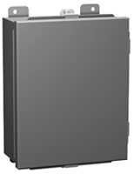
WCARC Propagation Beacons
Hammond 1414 N4 PHM6 NEMA 4 Painted Steel Enclosure
Full weather protection for outdoor use – grey, re-paintable
Stainless steel continuous hinge, removable front door
Outside dimensions 14”H X 12”W X 6”D. Removable inner back panel – 12.75” X 11”, for mounting electronic modules.

Slide 24
WCARC Propagation Beacons
Beacon Antennas
Ottawa’s location does not favour directional beacon antennas so omni-directional antennas are preferred. Horizontal polarization is optimum for weak signal beacon use, as their primary application is not for vertically polarized mobiles.
PAR is busy with government work so wants no more ham business for now! KB6KQ is QRX, due to owner illness.
That leaves KU4AB as the primary source for reasonably priced horizontally polarized , omni-directional antennas
KU4AB omnis have solid rod aluminum elements, and stainless steel hardware with U-bolt mounting for up to 1.5” masting.
Stacking at half wavelength (on higher band) on 1.5” non-metal mast produces minimal interaction between antennas.

Slide 25
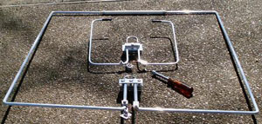
WCARC Propagation Beacons
KU4AB SQ-50 6M Omni (32” X 32”) US$71.95
SQ-144 and nut driver shown for size comparison

Slide 26
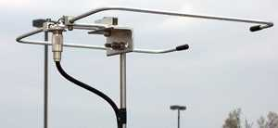
WCARC Propagation Beacons
KU4AB SQ-144 2M Omni US$32.95

Slide 27
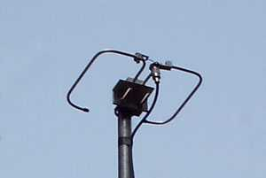
WCARC Propagation Beacons
KU4AB SQ-222 1.25M Omni US$34.95

Slide 28
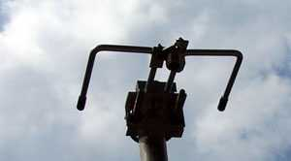
WCARC Propagation Beacons
KU4AB SQ-432 70CM Omni US$34.95

Slide 29
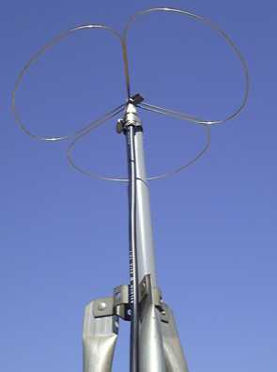
WCARC Propagation Beacons
Olde Antenna Labs, Inc 2M Big Wheel version shown
Mini Wheel Horizontal Omni Antennas for 35 or 23CM US $55
VHF units are bulkier and more expensive than KU4AB omnis

Slide 30
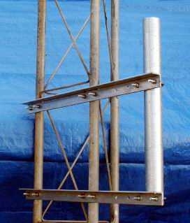
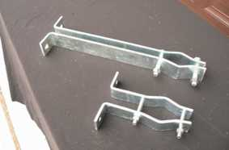
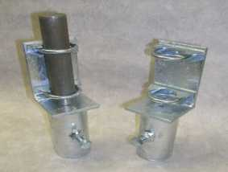
WCARC Propagation Beacons
W9IIX Equipment Ltd – hot dip galvanized tower adapters
SO-5 (39”) – US$139/pr; SM-5 – US$59/pr; MA-2/1.5 – US$69

Slide 31
WCARC Propagation Beacons
Pricing Summary
TA51 Kit c/w crystal and oven (6, 2 or 1.25M) US $ 204
TA451 Kit c/w crystal and oven (70CM) US $ 204
TB901 W&T c/w crystal and oven (35CM) US $ 274
COR-4 CW ID Module kit US $ 109
Hammond 1414N4PHM6 NEMA 4 enclosure US $ 152
KU4AB SQ-50 Omni Antenna US $ 72
KU4AB SQ-144 Omni Antenna US $ 33
KU4AB SQ-222 Omni Antenna US $ 35
KU4AB SQ-432 Omni Antenna US $ 35
Olde Antenna Labs Mini-Wheel Omni Ant (35, 23CM) US $ 55
IIX Equipment Tower Brackets and Adapters (set) US $ 267

Slide 32
WCARC Propagation Beacons
Location, Location, Location
VO1NO/VE3 is remote from Ottawa (in FN24cw), so is not an ideal location for an Ottawa beacon. Al will be moving to NS within five years so that beacon location would be temporary.
VE3XK is in West Carleton (FN15wg) - closer to the city and to the VA3KS 2M beacon (also FN15wg). Space is available on the side of the VE3XK tower ~50 ft above ground level. But VE3XK is far from our 35CM beacon, so is not the ideal permanent site.
Is there any location near the city core where we can place all of our beacons for maximum value to the amateur community – a high-rise like YMCA or Booth St, RAC HQ? If we eventually colocate all our beacons remote from FN15, we should consider including both 2M and 6M beacons at that location.

Slide 33
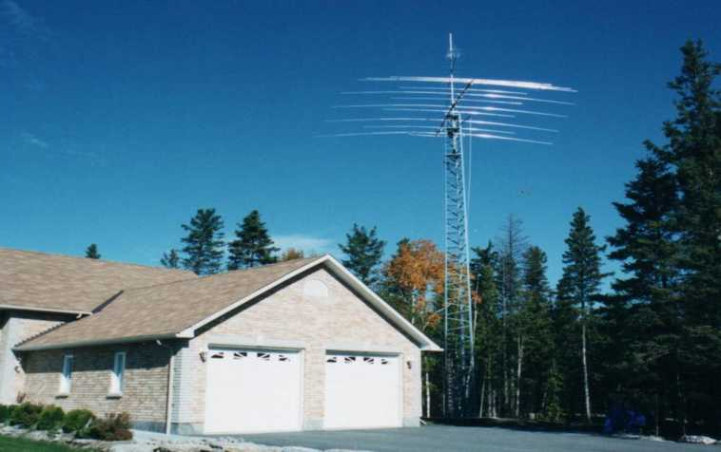
WCARC Propagation Beacons
VE3XK Tower

Slide 34
WCARC Propagation Beacons
Rationale
A subtle benefit to this multi-band tower-mounted configuration is the easy portability of the assembly including antennas. It is modular so can be purchased and installed one band at a time.
The need for local 6M, 2M and 35CM beacons is already met, so our initial focus should be on 1.25M with 70CM later (or 70CM now with 1.25M later), and 23CM in a future year.
The proposed Phase 1 includes the first exciter, the keyer module and enclosure together with omni antenna, cables, connectors and essential hardware.
The proposed Phase 2 is for the second band at a later date.
2M could be added later at the same cost as Phase 2.
The proposed Phase 3 is for the 23CM band

Slide 35
WCARC Propagation Beacons
Phase 1 – 2008
1. Purchase of 1.25M TA-51* Kit w/oven/crystal plus COR-4 Keyer kit. *(This could be 70CM TA-451 for the same $380).
2. Verify current Hamtronics quality and check the –50 dB harmonic and spurious claims with a spectrum analyzer.
3. If all OK so far, connect exciter to the Keyer to confirm ease and keying performance of the Hamtronics exciters.
4. If OK, purchase, for $620, enclosure, antenna, brackets and masting, mount and wire exciter and keyer modules, install mounting brackets, antenna and mast to hang off the tower.
Location: at VE3XK (for initial access convenience). If possible, space will be made available for the 6M beacon.
I will be asking you to vote on my motion to approve Phase 1.

Slide 36
WCARC Propagation Beacons
Phase 2 – 2008/2009
1. Purchase and install 70CM TA-451* Kit w/oven/crystal
*This could be 1.25M TA-51 Kit if 70CM bought first.
2. Purchase and install SQ-432* Omni Antenna on mast
*This could be SQ-222 if 70CM bought first.
3. Purchase and install coaxial cable, and miscellaneous mounting hardware
Any motion to approve Phase 2 would follow initial success with Phase 1, and probably a year later.

Slide 37
WCARC Propagation Beacons
Phase 3 – 2009/2010 (or later)
Phase Three is an optional project to add a 23CM beacon to the enclosure and antenna stack.
The adaptation of a 35CM TB-901 to 23CM looks feasible, but maybe Hamtronics will be offering a 23CM Exciter by then.
Also required:
a) 23CM Mini Wheel omni antenna
b) additional cable and misc hardware
Deployment of a 23CM beacon at the VE3XK location is feasible but not ideal. Relocation with our 35CM beacon to a central site would be preferred.
Any motion to approve Phase 3 would follow successful Phase 2

Slide 38
WCARC Propagation Beacons
Proposed WCARC Beacon Frequencies
6M – 50.009 MHz
2M – 144.297 MHz (or VA3KS/VA3SJS beacon – 144.293 MHz)
125CM – 222.063 MHz
70CM – 432.358 MHz
35CM – 903.354 (existing)
23CM – 1296.210
All these frequencies are unused, according to the latest G3USF and WZ1V web listings, and are well away from any nearby beacons.

Slide 39
WCARC Propagation Beacons
Our Administrative Obligation
Amateur radio propagation beacon monitoring stations are quite common, and very active in Europe and North America.
Whatever VHF/UHF/SHF beacon(s) we decide to deploy, we should be prepared for incoming QSL cards confirming that our beacon signal has been received at various DX locations, and requesting confirming QSL cards in return. (QSL cards will be much more frequent at VHF/UHF than from our 35CM beacon).
We can use our standard VE3WCC QSL cards or design a new custom (photographic?) QSL card to confirm our beacon reception reports, complete with details of our beacons. Reducing our beacon systems “to print” is another reason to be professional in their design and operation.

Slide 40
WCARC Propagation Beacons
Thanks
for your attention (and endurance)
de
VE3XK

